Slide 1

Bahir Dar Institute of technology Faculty of Electrical and Computer Engineering Department of Computer Engineering MSc in Computer Engineering
Band pass FIR Design Using modelsim and Alliance
Name ID
1. Amualto Lakew…………………………….………...BDU1200472
2. Bekalu Mogne…………………………….………….BDU1200475
3. Bekalu Nakachew……………………….……………BDU1200478
4. Tilahun Asfaw………………………..…………....….BDU1200488
Submitted to : Kinde A.(PHD)
Date :20 Aug 2020 G.C

Slide 2
Outline
Introduction
System Specifications
Design Stages
Simulation
Synthesis
Performance improvement
Conclusion

Slide 3
Introduction
FIR filters also known as non-recursive digital filters have a finite impulse response because after a finite time the response of FIR filter settles to zero.
They are exactly linear phase can easily be designed. We have designed a bandpass filter which has cutoff frequencies of fcl = 0.4 and fc2= 0.6.

Slide 4
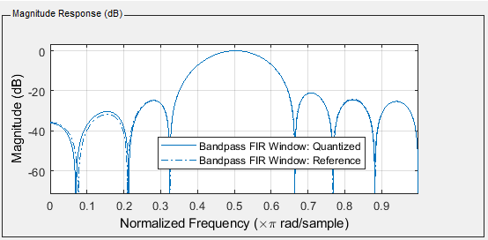
Introduction cont . . .
A 15 order direct-form FIR band pass filter using different window functions is designed using the specifications.

Slide 5
System Specification
FIR impulse response
15 order and single rated filter
Its cutoff frequencies are f1=0.4 and f2=0.6
It is fixed point Arithmetic filter
floor rounding mode and saturated overflow.
Window design method
Filter internal specified precision

Slide 6
System Specification cont . . .
8-bit input signal word length.
8-bit word length 16 coefficients
16-bit product word length
18-bit accumulator word length
16-bit output word length
16 multiplier
Fully parallel architecture

Slide 7
Design Stages
Filter designing and analysis tool (FDATool) is used for designing the digital filters.
The Design of a digital filter involves the following five steps:
Filter specification
Filter coefficient calculation
Realization
Analysis of finite word length effect
Simulate the generated VHDL on MODELSIM and Synthesis.
Implementation.

Slide 8
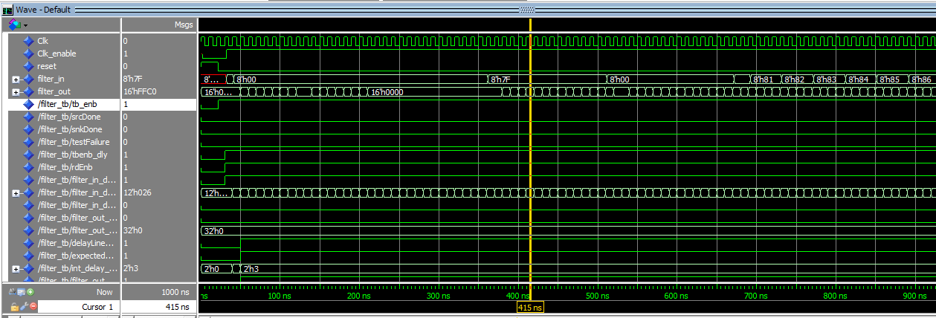
Simulation
We are trying to simulate and test our bandpass filter on both matlab and modelsim. We have got satisfying result for each.

Slide 9
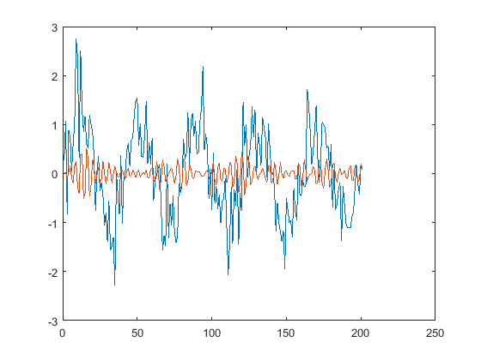
Simulation cont . . .
After removal of the jitter or delay between the signals

Slide 10
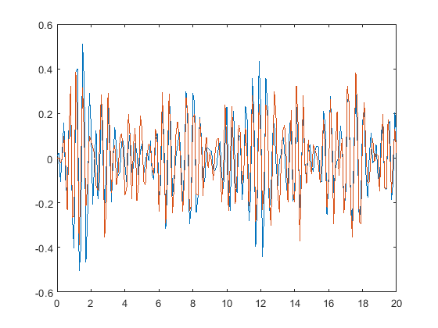
Simulation cont . . .
after applying our filter extracted from matlab

Slide 11
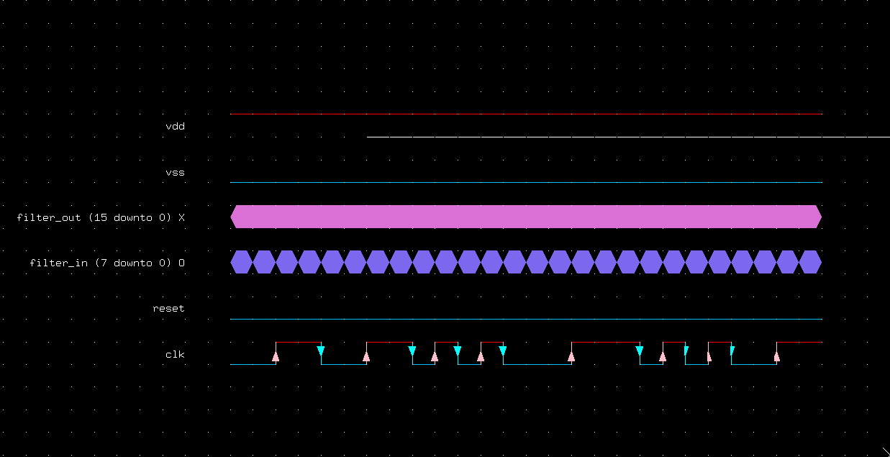
Synthesis
The synthesis part is done on the alliance CAD tool. The input output wave form of the simulation is shown below.

Slide 12
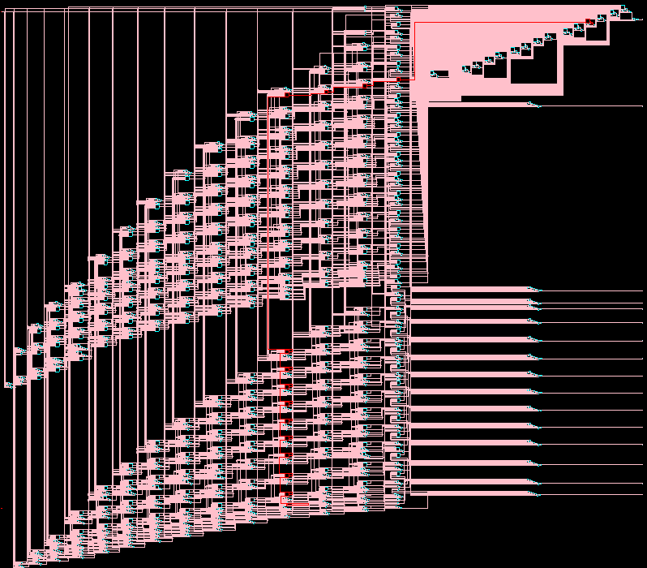
Synthesis cont . . .
The Schematic diagram of the system is shown below.

Slide 13
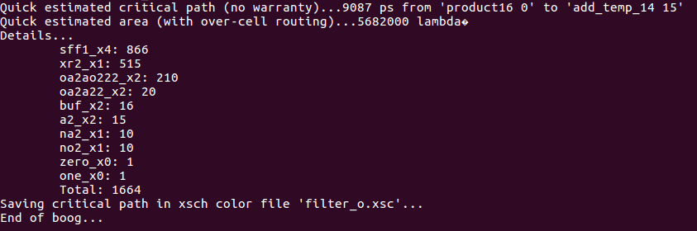
Synthesis cont . . .
The second step synthesis BOOG that containing information about the total no. of gates of the filters.

Slide 14
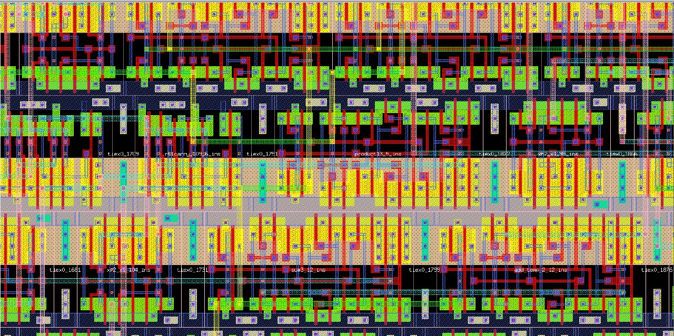
Synthesis cont . . .
The physical symbolic layout file with physical connectors and placed cells. now ready to take our design into the layout phase in the design process.

Slide 15
Performance improvement
The kaiser window method found to be the best and easiest model than other common structures .
The filter word length and size of filter order have valuable effect on FIR performance.
window design method is relatively simple and easy to use as compared to other methods.

Slide 16
Conclusion
Our bandpass filter specifications have been simulated and synthesized properly and we get satisfying results. This fir filter performance can be improved by taking appropriate specifications.
We have synthesized it using alliance and we determine the number of gates required.

Slide 17
THANK YOU !

